Slide 1
Program Name goes here
Link to github Repository: https://github.com/jhkfgjflkdjg/pizzabot
Links to trello board / project management tools:Trello
You MUST provide evidence showing how the problem has been decomposed, how the components have been developed and trialled, and of how they have been assembled and tested to create a final, working outcome.

Slide 2
Relevant Implications
Explain the relevant implications here. Please watch this video to learn how to do this.
Notes:
Explain the relevant implications here. Then as you work, develop your code, discuss how the implications are being met.

Slide 3
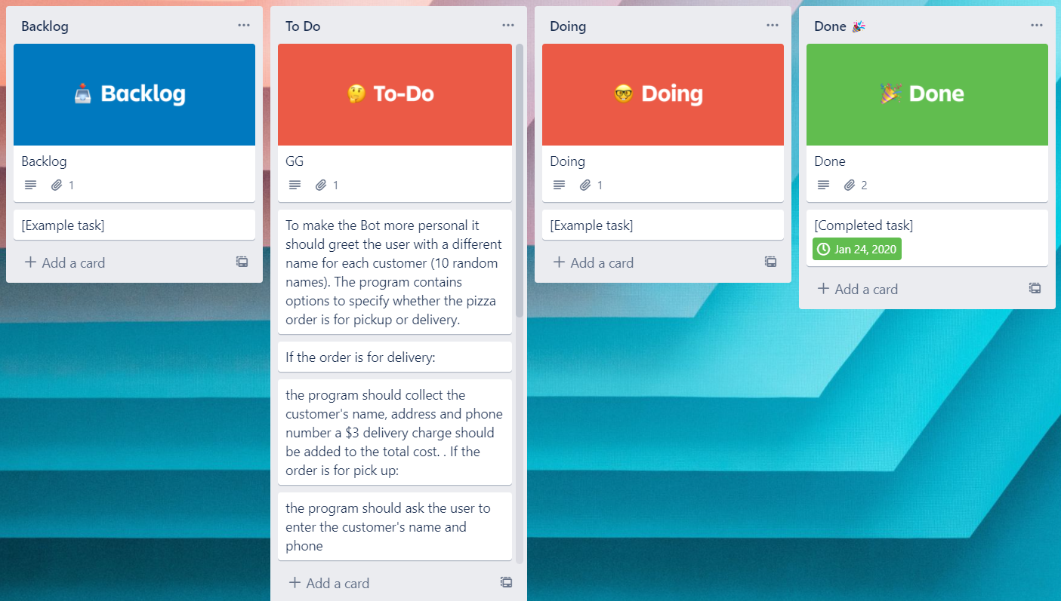
Decomposition
Paste screenshots of your initial Trello board / task decomposition on this slide. If you have a long list, you might need to break it up into several columns. Delete this instruction when you are done.
Notes:
Paste screenshots of your initial Trello board / task decomposition on this slide. If you have a long list, you might need to break it up into several columns. Delete this instruction when you are done.

Slide 4
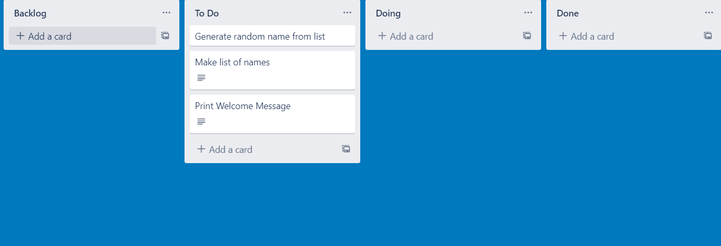
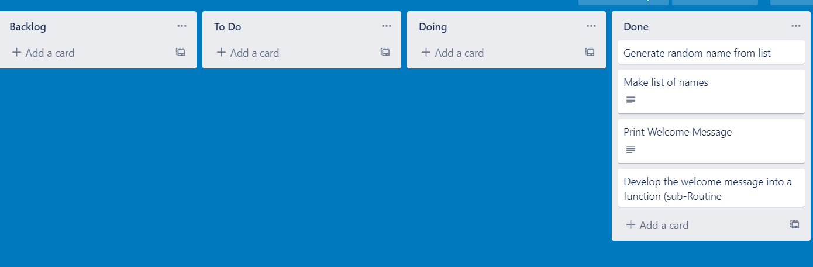
Component 1 (Trello screenshot)
Version 1
Version 2

Slide 5
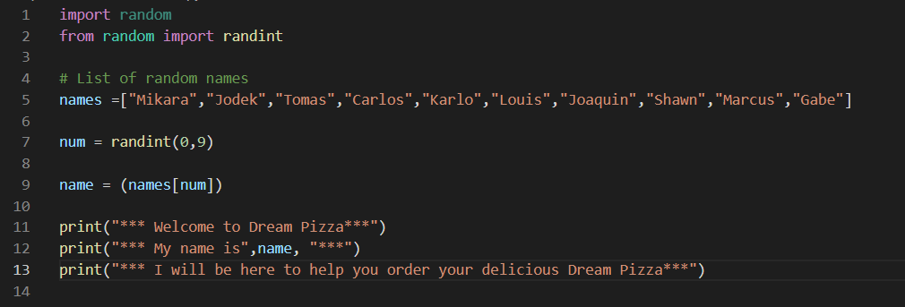

Component 1 - Test Plan (and screenshot)
Test Case | Expected Values
Run program | Print welcome message with random name from list of names – Runs correctly

Slide 6
Component 1 version 2 - Test Plan (and screenshot)
Test Case | Expected Values
Run program | Print welcome message with random name from list of names – Runs correctly

Slide 7
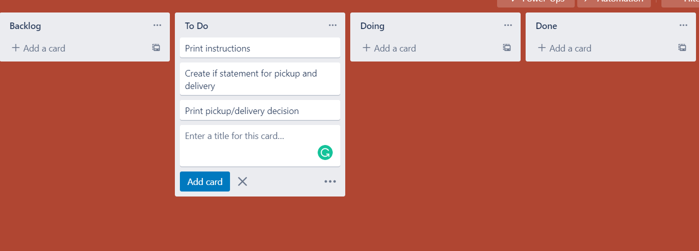
Component 2 (Trello screenshot)

Slide 8
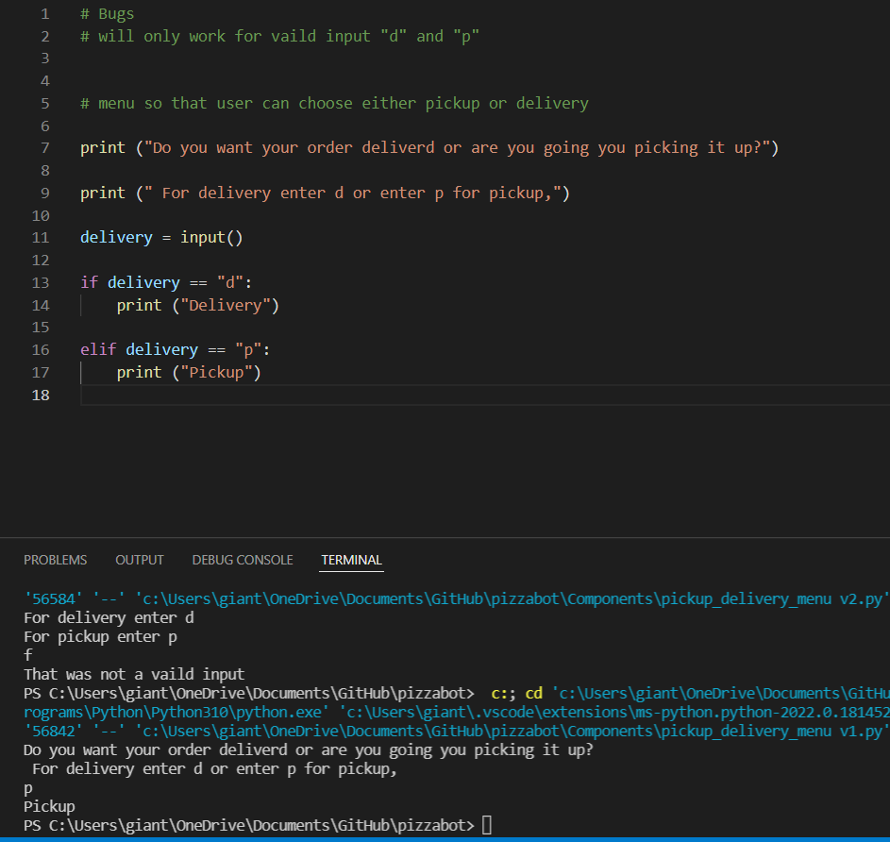
Component 2 version 1 - Test Plan (and screenshot)
Test Case | Expected Values
Run program | Enter p program prints pickup Enter d program prints delivery Enter invalid program prints stops.

Slide 9
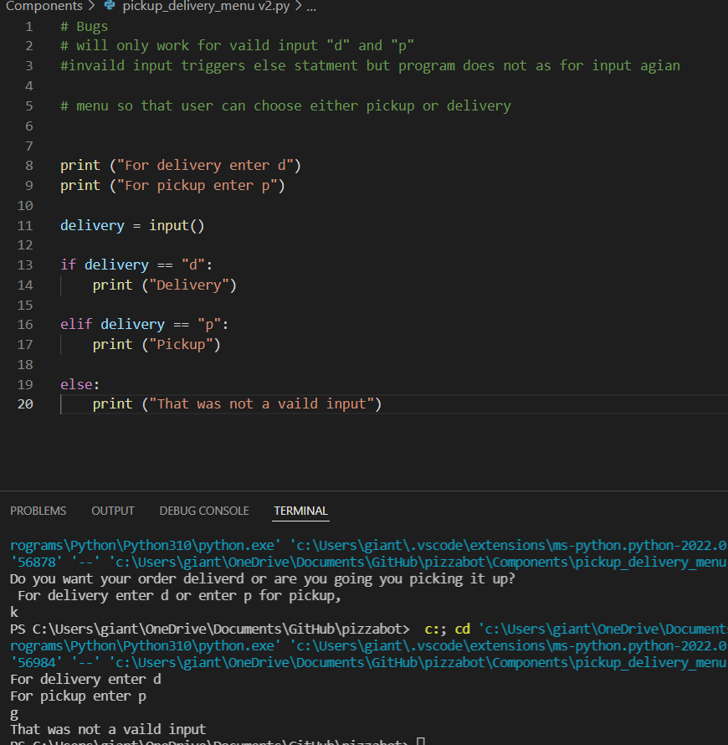
Component 2 version 2 - Test Plan (and screenshot)
Test Case | Expected Values
Run program | Enter p program prints pickup Enter d program prints delivery Enter invalid prints error message.

Slide 10
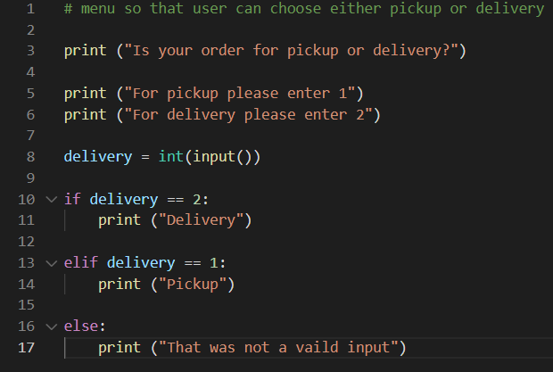
Component 2 version 3 - Test Plan (and screenshot)
Test Case | Expected Values
Run program | Enter 1 program prints pickup Enter 2 program prints delivery Enter invalid program display value error.

Slide 11
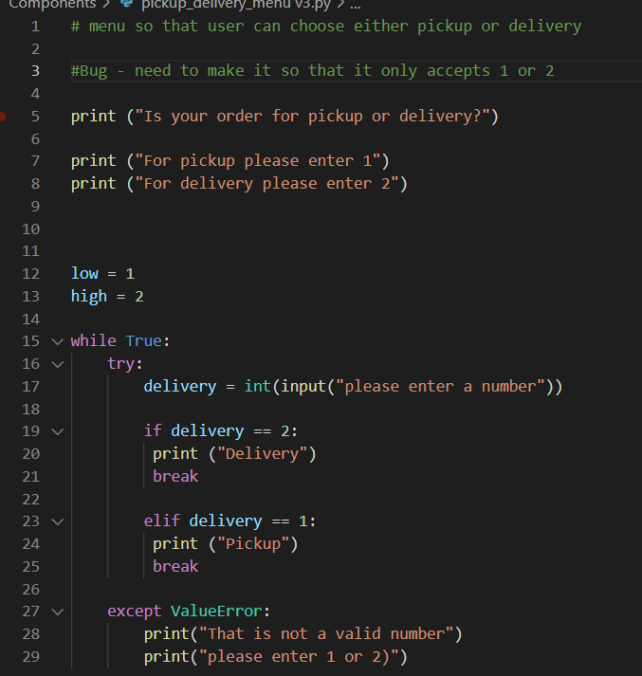
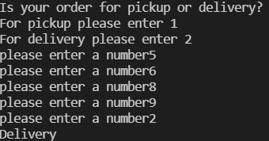
Component 2 version 4 - Test Plan (and screenshot)
Test Case | Expected Values
Run program | Enter p program prints pickup Enter d program prints delivery Enter invalid prints error message. Enter number other than 1 or 2 does not work.

Slide 12
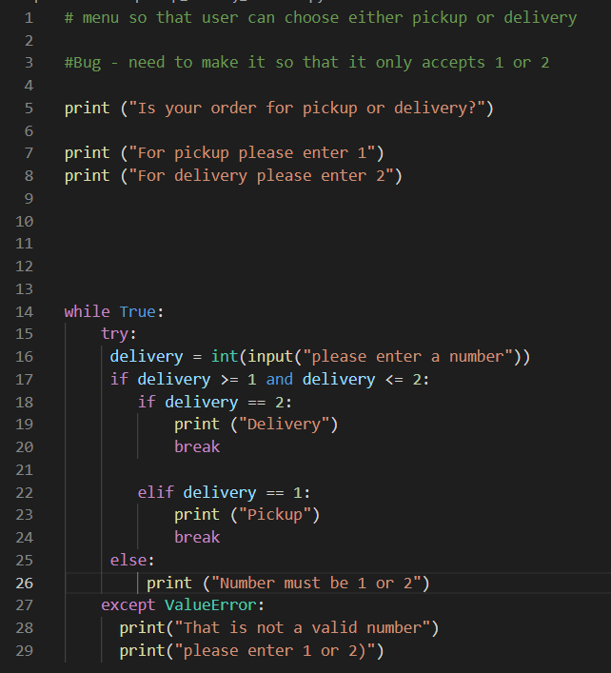
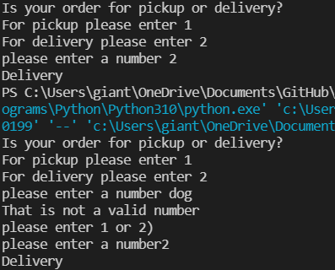
Component 2 version 5 - Test Plan (and screenshot)
Test Case | Expected Values
Run program | Enter p program prints pickup Enter d program prints delivery Enter invalid entry - error message the task for input again. Enter number other than 1 or 2 – error message asks for entry again.

Slide 13
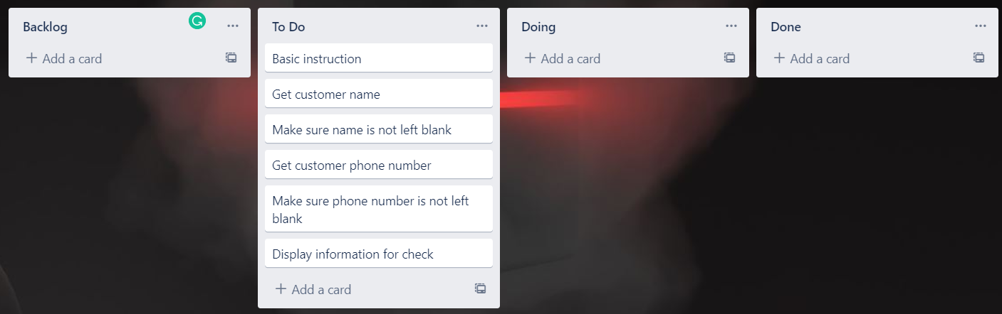
Component 2 pickup information (Trello screenshot)

Slide 14
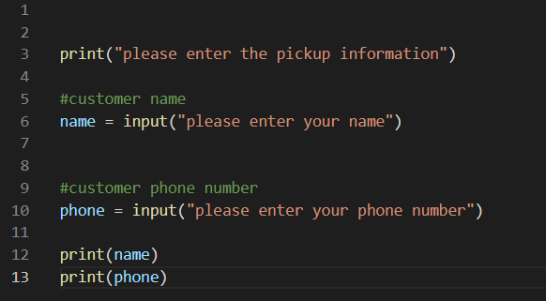
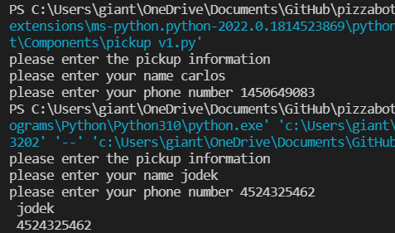
Component 3 v1 - Test Plan (and screenshot)
Test Case | Expected Values
Input name Input phone number Left input blank | Printed name correctly Printed phone number correctly Accepted blank and printed blank input

Slide 15
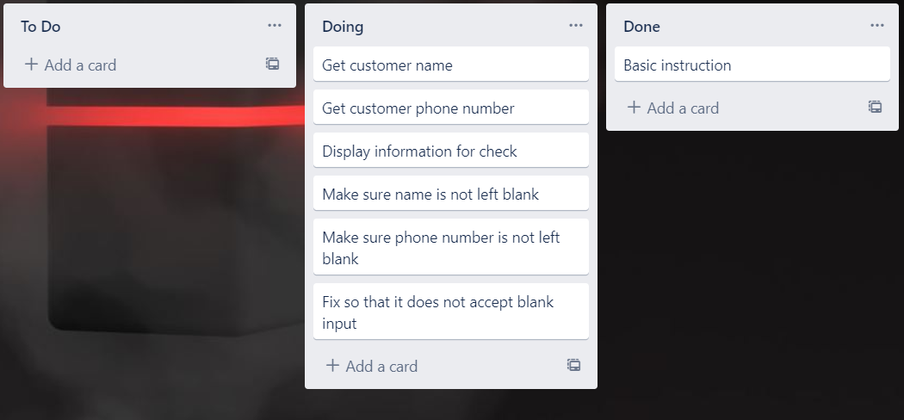
Component 2 pickup info v2 (Trello screenshot)

Slide 16
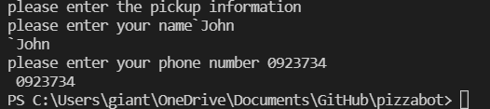
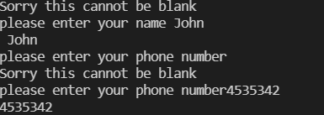
Component 3 v2 - Test Plan (and screenshot)
Test Case | Expected Values
Input name Input phone number Left input blank | Printed name correctly Printed phone number correctly Printed “Sorry this cannot be blank” – goes back to input.

Slide 17
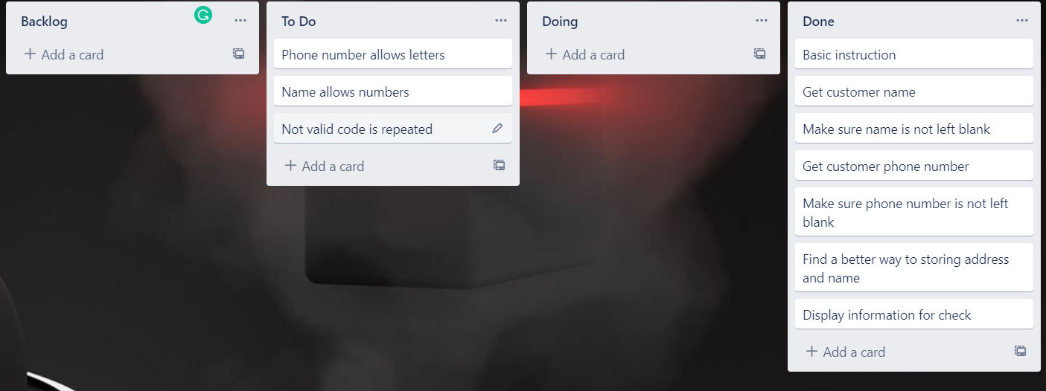
Component 2 pickup info v3 (Trello screenshot)

Slide 18
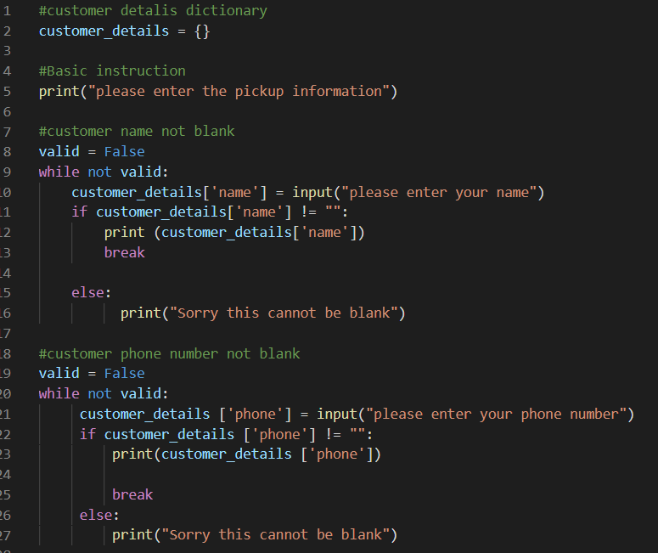
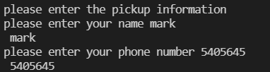
Component 3 v3 - Test Plan (and screenshot)
Test Case | Expected Values
Input name Input phone number Left input blank | Printed name correctly Printed phone number correctly Printed “Sorry this cannot be blank” – goes back to input.

Slide 19
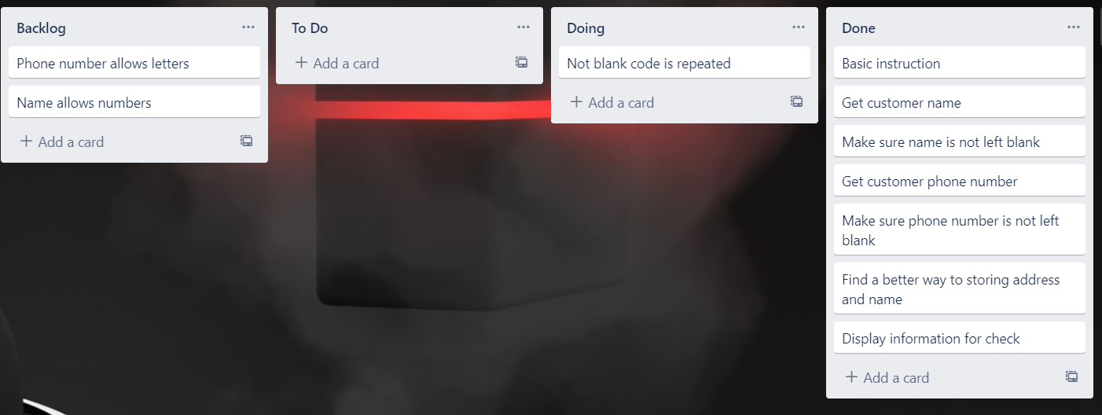
Component 2 pickup info v4 (Trello screenshot)

Slide 20
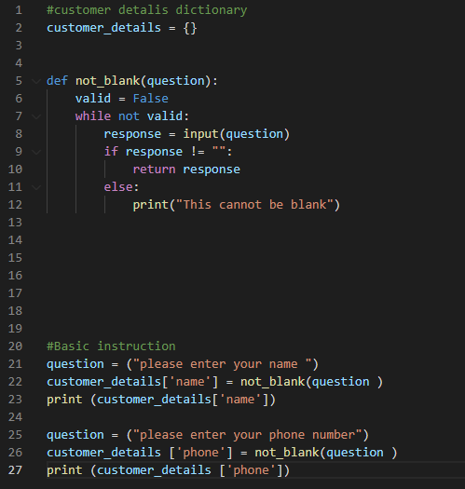
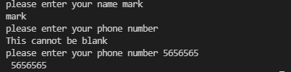
Component 3 v4 - Test Plan (and screenshot)
Test Case | Expected Values
Input name Input phone number Left input blank | Printed name correctly Printed phone number correctly Printed “Sorry this cannot be blank” – goes back to input.

Slide 21
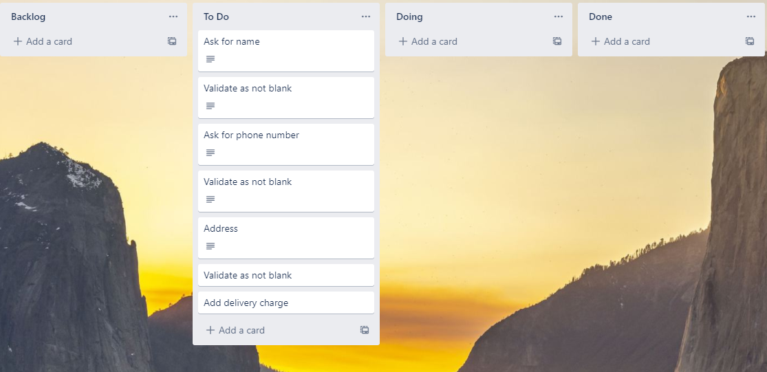
Component 4 pickup information (Trello screenshot)

Slide 22
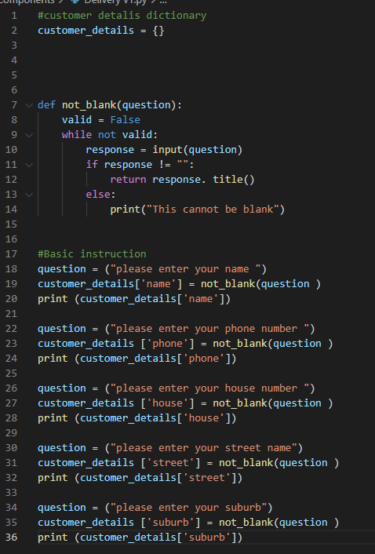
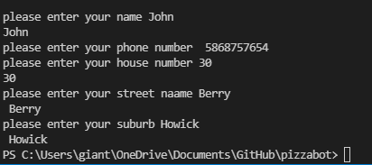
Component 4 v1 - Test Plan (and screenshot)
Test Case | Expected Values
Input name Input phone number Input house number street name Suburb name Left input blank | Printed name correctly Printed phone number correctly Accepted blank and printed blank input Printed street name Printed suburb name Asked for input agian

Slide 23
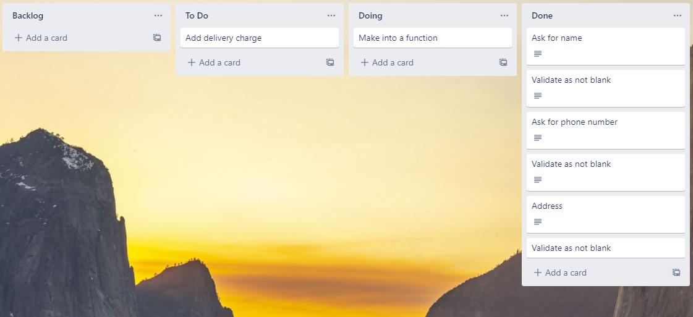
Component 4 pickup infor version 2

Slide 24
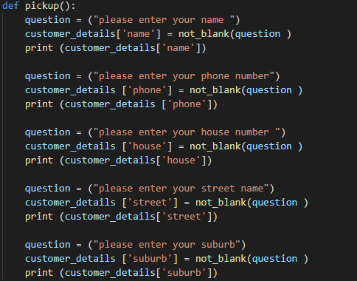
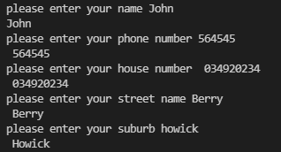
Component 4 v2 - Test Plan (and screenshot)
Test Case | Expected Values
Input name Input phone number Input house number street name Suburb name Left input blank | Printed name correctly Printed phone number correctly Printed house number Printed street name Printed suburb name Asked for input again

Slide 25
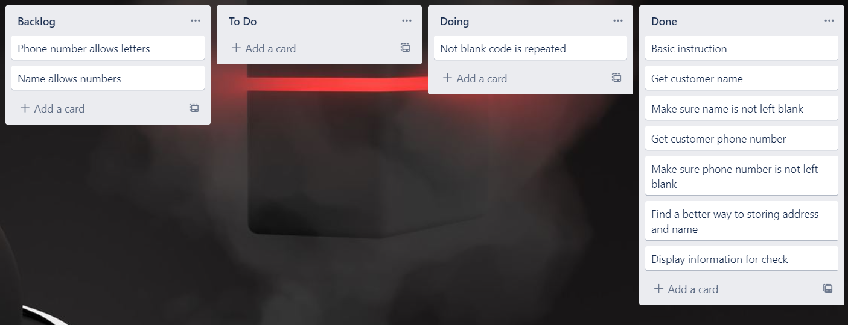
Component 4 pickup infor version 2

Slide 26
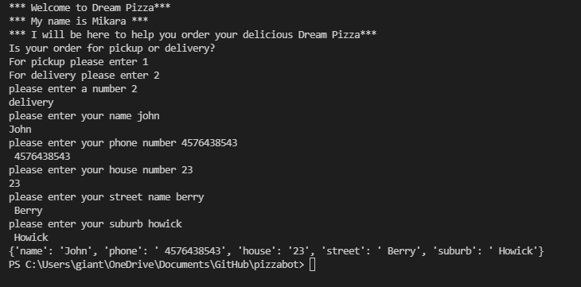
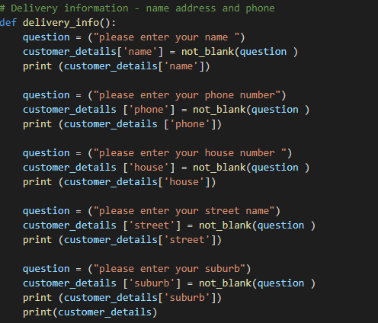
Component 4 v2 - Test Plan (and screenshot)
Test Case | Expected Values
Input name Input phone number Input house number street name Suburb name Left input blank | Printed name correctly Printed phone number correctly Printed house number Printed street name Printed suburb name Asked for input again

Slide 27
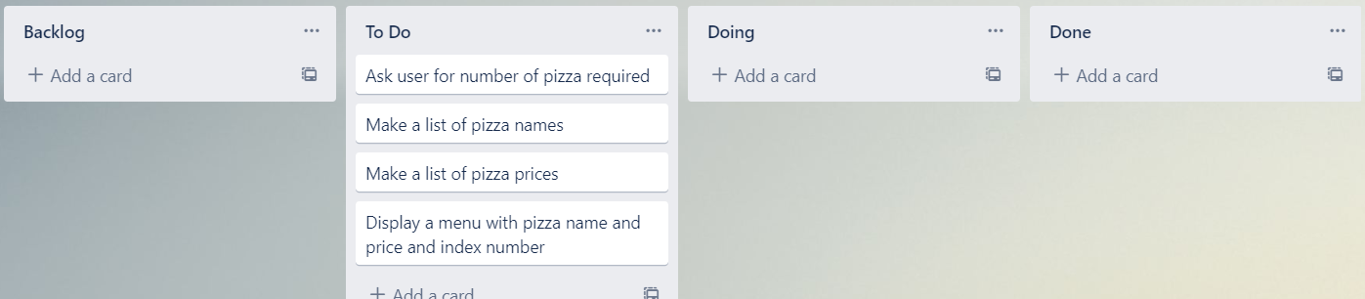
Component 5 Pizza menu (Trello screenshot)

Slide 28
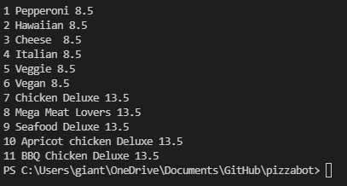
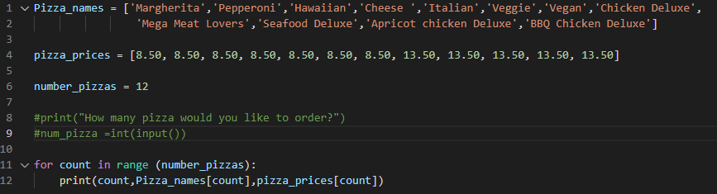
Component pizza menu 5 v1
Test Case | Expected Values
Run file | Printed a list with index number, pizzas and prices

Slide 29
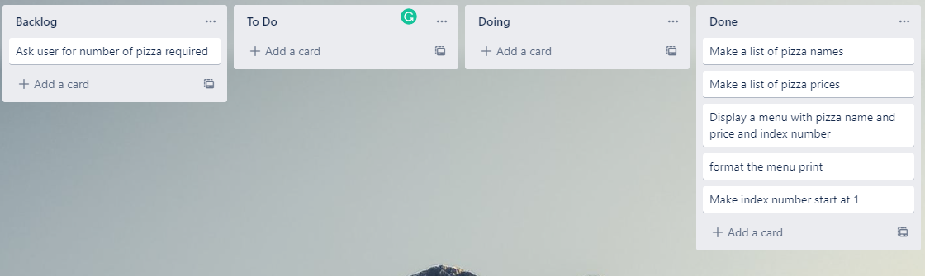
Component 5 Pizza menu (Trello screenshot)

Slide 30
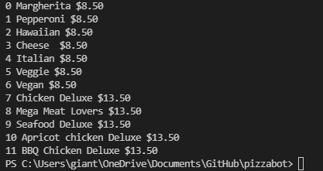
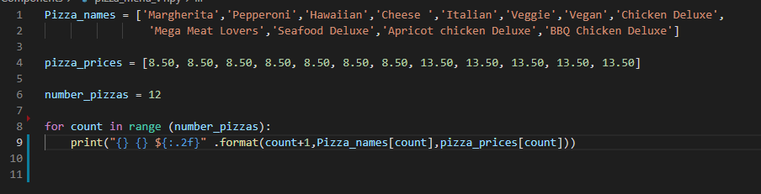
Component pizza menu 5 v2
Test Case | Expected Values
Run file | Printed a list with index number, pizzas and prices with price formatted to 2 decimal places and dollar sign. Menu starts at.

Slide 31
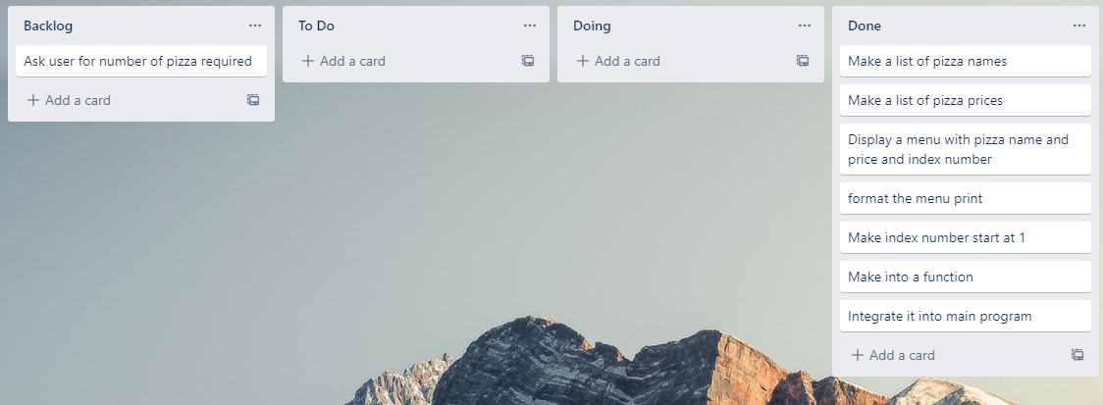
Component 5 Pizza menu v3 (Trello screenshot)

Slide 32
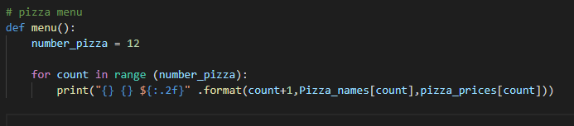
Component 5 pizza menu integrated into main program
Test Case | Expected Values
Run file | Printed a list with index number, pizzas and prices with price formatted to 2 decimal places and dollar sign. Menu starts at.

Slide 33
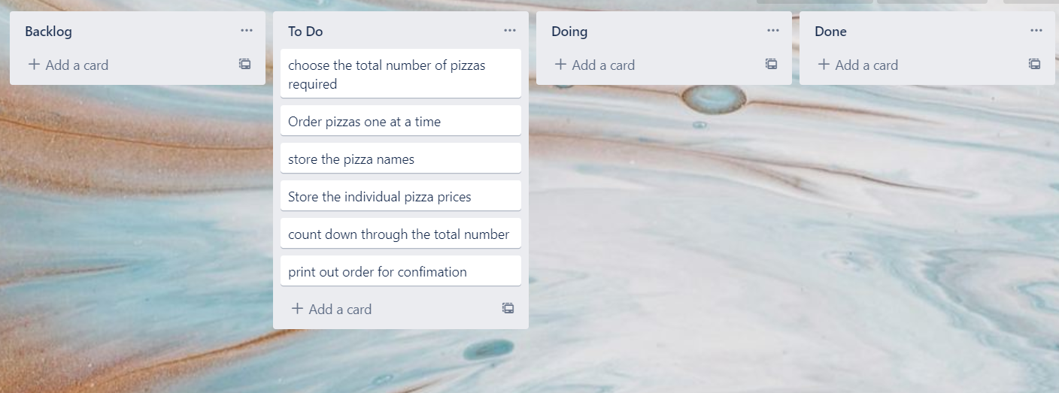
Component 5 Pizza Order v1 (Trello screenshot)

Slide 34
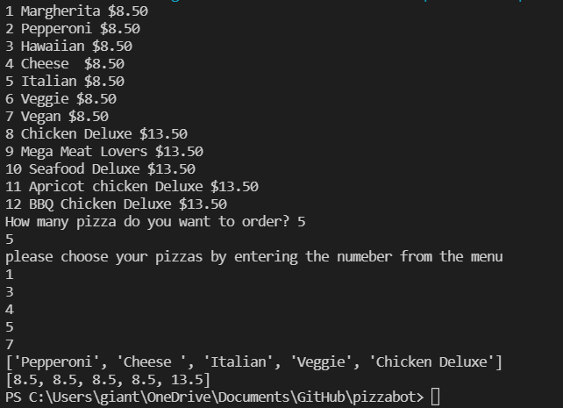
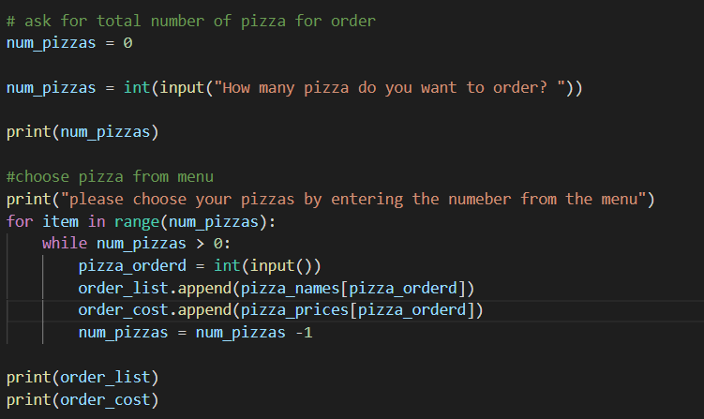

Component 6 pizza order v1
Test Case | Expected Values
Entered 5 pizzas Entered cat | Stepped through the menu choice 5 times Programmed broke

Slide 35
Version Control Evidence
Your version control evidence should go here. This could be in the form of annotated screenshots which show you you managed this process or you could make a brief screencast explaining how you implemented version control.
Notes:
Your version control evidence should go here. This could be in the form of annotated screenshots which show you you managed this process or you could make a brief screencast explaining how you implemented version control.

Slide 36
Discusses how the information from planning, testing and trialling of components assisted in the development of a high-quality outcome
Notes:
Discusses how the information from planning, testing and trialling of components assisted in the development of a high-quality outcome

